Slide 1
Module-3
Industrial Designs, Geographic Indications, Trade Secret

Slide 2
Syllabus:
Industrial Designs– Introduction – Need for protection of design– requirements for registration of designs – Design Act,2000 –Duration of registration of design – application procedure
Geographic Indications –Introduction – Filing – Granting – Protection of geographic indications.
Trade Secret – definition – discovering and protecting of trade secret.

Slide 3
Industrial Designs

Slide 4
Introduction
A design refers to the features of shape, configuration, pattern, ornamentation or composition of lines or colors applied to any article, in two or three dimensional (or both) forms.
Design doesn't include any mode or principle of construction or anything which is mere mechanical device.
In a legal sense, it constitutes the ornamental aspect of an article.
Industrial designs are applied to a wide variety of products of industry and handicraft items: from packages and containers to furnishing and household goods, from lighting equipment to jewelry, and from electronic devices to textiles.
Industrial designs may also be relevant to graphic symbols, graphical user interfaces (GUI), and logos.
In most countries, an industrial design needs to be registered in order to be protected under industrial design law as a “registered design”.
In some countries, industrial designs are protected under patent law as “design patents ”.

Slide 5

Eg: Industrial designs that combines aesthetic appeal with creative problem-solving.
Coke Contour Bottle
The Coca-Cola contour bottle is a masterpiece in industrial design that dates back to 1915 when the Coca-Cola Company asked its bottle suppliers to design a new bottle that would be distinctive and instantly recognisable - even in the dark.
Designer Earl R. Dean took up the challenge, and following instructions issued by his boss, aimed to come up with a design based on the ingredients of the drink.

Slide 6
Difference between an industrial design right and a patent.
An industrial design right protects only the appearance or aesthetic features of a product, whereas a patent protects an invention that offers a new technical solution to a problem.
In principle, an industrial design right does not protect the technical or functional features of a product.
Such features could, however, potentially be protected by a patent.

Slide 7

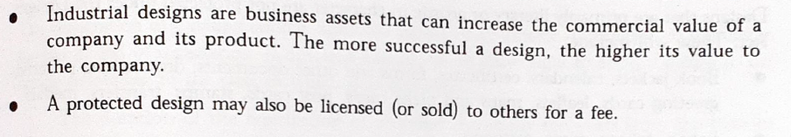

Slide 8
Requirements for the Registration of Design
The design should be new or original , not previously or used in any country before the date of application for registration. The novelty may reside in the application of a known shape or pattern to a new subject-matter.
The design should relate to features of shape, configuration, pattern or ornamentation applied or applicable to an article.
The design should be applied or applicable to any article by any industrial process.
The features of the designs in the finished article should appeal to and are judged solely by any eye. This means that the design must appear and should be visible on the finished article, for which it is meant.

Slide 9
Requirements for the Registration of Design
Any mode or principle of construction or operation or anything, which is in substance a mere mechanical device , would not be a registrable design.
The design should not include any trademark or property mark or artistic works.
It should be significantly distinguishable from known designs or combination of known designs
It should not comprise or contain scandalous or obscene matter

Slide 10
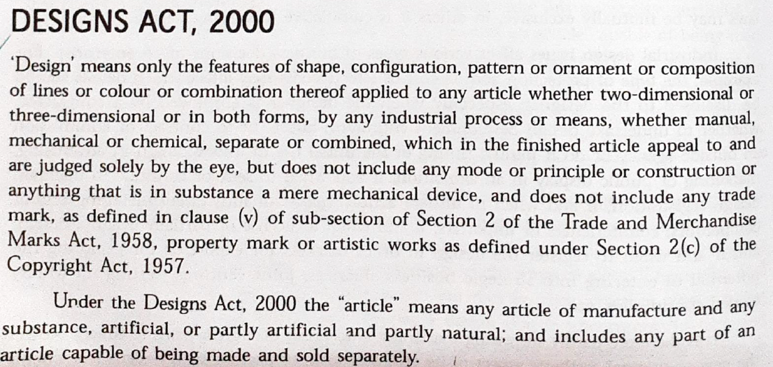

Slide 11
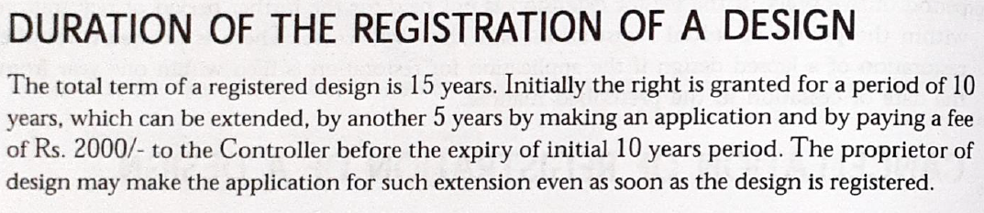

Slide 12
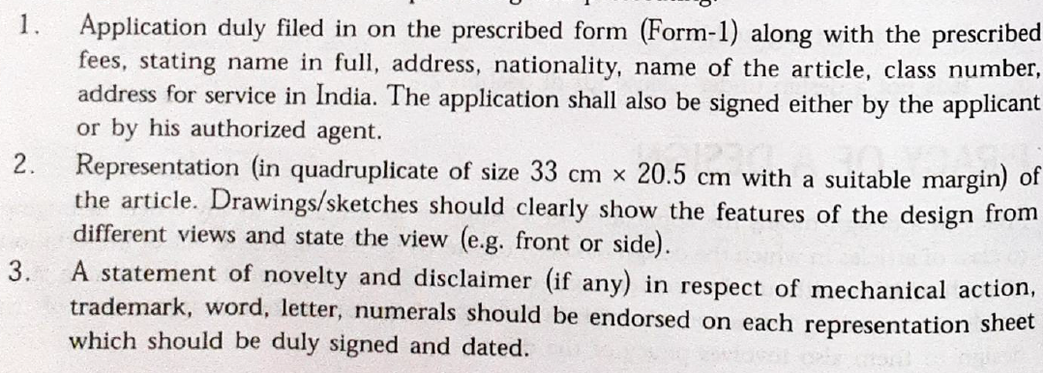
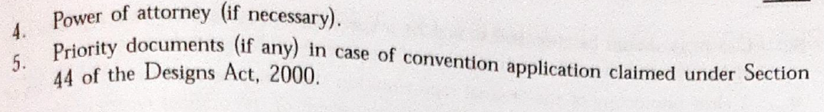
Application Procedure

Slide 13
Acceptance&Notification:-An application is accepted when all the shortcomings have been rectified. It is then notified in the Patent Office journal which is published on every Friday.
Refusal:-In case the defects as required by the Controller are not rectified, a hearing will be provided to the applicant. After hearing the controller shall decide whether the application should be accepted or not. The decision of the Controller will be communicated in writing to the applicant or his agent stating the reasons for the decision.
Appeal:-Any person aggrieved by the decision of the Controller refusing to register a design may appeal to the High Court. The appeal should be made within three months from the date of the Controller's decision.
Abandonment:-An application which owing to any neglect or default on the part of the applicant has not been completed so as to enable registration to be effected within six months or within extended period will be treated as abandoned.

Slide 14
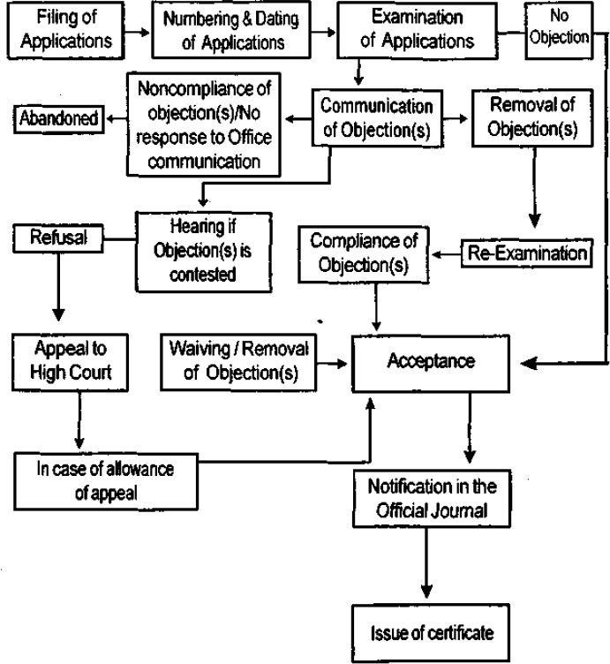
Flowchart of design application upto acceptance

Slide 15
Geographic Indications (GI)

Slide 16
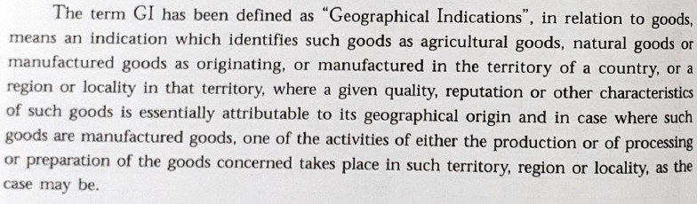
Introduction
A geographical indication (GI) is a sign used on products that have a specific geographical origin and possess qualities or a reputation that are due to that origin.
In order to function as a GI, a sign must identify a product as originating in a given place.
In addition, the qualities, characteristics or reputation of the product should be essentially due to the place of origin.
Since the qualities depend on the geographical place of production, there is a clear link between the product and its original place of production.

Slide 17
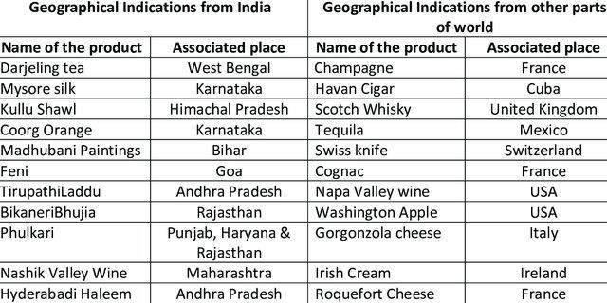

Slide 18
Eg: SWISS WATCHES
The appellation “SWISS” (or, in its most common form, “Swiss Made”) affixed to a watch means that the watch was manufactured in Switzerland according to the tradition, knowhow and quality criteria of Swiss watchmaking, which enjoys a great reputation around the world.
The Federal Council Ordinance of December 23, 1971 to regulate the use of the “SWISS” appellation for watches was partially revised on June 17, 2016 at the request of the industry, in order to strengthen the protection of the geographical indication.
According to the Federation of the Swiss Watch Industry, the intention is to “guarantee satisfaction of the consumer who, when buying a Swiss made watch, expect it to correspond to the quality and the reputation of Swiss watchmaking tradition and therefore to be manufactured in Switzerland and to incorporate a high added value of Swiss origin.”

Slide 19
Difference between a geographical indication and a trademark?
Geographical indications and trademarks are distinctive signs used to distinguish goods or services in the marketplace.
Both convey information about the origin of a good or service, and enable consumers to associate a particular quality with a good or service.
Trademarks inform consumers about the source of a good or service. They identify a good or service as originating from a particular company. Trademarks help consumers associate a good or service with a specific quality or reputation, based on information about the company responsible for producing or offering it.
Geographical indications identify a good as originating from a particular place.Based on its place of origin, consumers may associate a good with a particular quality, characteristic or reputation

Slide 20
A trademark often consists of a fanciful or arbitrary sign that may be used by its owner or another person authorized to do so. A trademark can be assigned or licensed to anyone, anywhere in the world, because it is linked to a specific company and not to a particular place.
In contrast, the sign used to denote a GI usually corresponds to the name of the place of origin of the good, or to the name by which the good is known in that place.
A GI may be used by all persons who, in the area of origin, produce the good according to specified standards. However, because of its link with the place of origin, a GI cannot be assigned or licensed to someone outside that place or not belonging to the group of authorized producers.

Slide 21
Appellations of origin
Appellations of origin are a special kind of GI. The term is used in the Paris Convention and defined in the Lisbon Agreement.
It consists of the name of the product’s place of origin.
However, it is interesting to note that a number of traditional indications that are not place names, but refer to a product in connection with a place, are protected as appellations of origin under the Lisbon Agreement (eg: Reblochon (cheese) and Vinho Verde (green wine)).
Both appellations of origin and GIs both require a qualitative link between the product to which they refer and its place of origin.
Both inform consumers about a product’s geographical origin and a quality or characteristic of the product linked to its place of origin. The basic difference between the two terms is that the link with the place of origin must be stronger in the case of an appellation of origin.

Slide 22
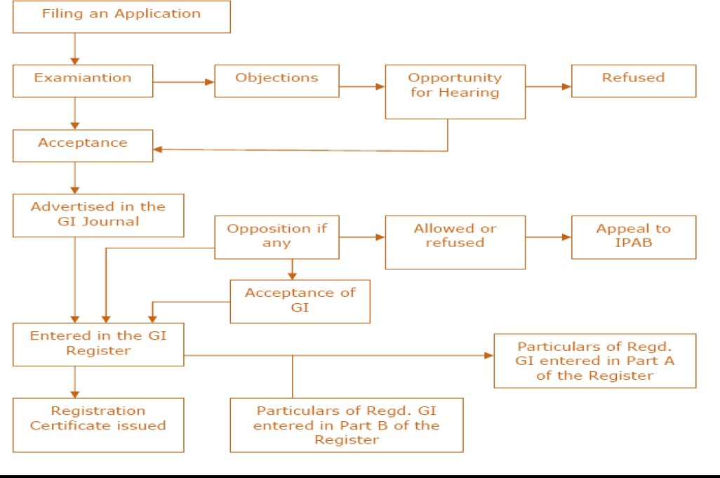
Registration process of GI in India

Slide 23
STEP 1 : Filing of application
Please check whether the indication comes within the ambit of the definition of a Gl under section 2(1)(e).
The association of persons or producers or any organization or
authority should represent the interest of producers of the
concerned goods and should file an affidavit how the applicant claims to represent their interest.
Application must be made in triplicate.
The application shall be signed by the applicant or his agent and must be accompanied by a statement of case.
Details of the special characteristics and how those standards are maintained.
Three certified copies of the map of the region to which the GI relates.
Details of the inspection structure if any to regulate the use of the GI in the territory to which it relates.
Give details of all the applicant together with address. If there is a
large number of producers a collective reference to all the
producers of the goods may be made in the application and the G.I., If registered will be indicated accordingly in the register.

Slide 24
Address of the office of Geographical Indications Registry: Intellectual Property Office Building
Industrial Estate, G.S.T Road Guindy, Chennai – 600 032
Phone: 044 – 22502091-93 & 98
Fax: 044 – 22502090
E-mail:gir-ipo@nic.in Website: ipindia.gov.in
The applicant must have an address for service in India.
Generally, application can be filed by
a legal practitioner
a registered agent

Slide 25
STEP 2 and 3: Preliminary scrutiny and examination
The Examiner will scrutinize the application for any deficiencies.
The applicant should within one month of the communication in this regard, remedy the same.
The content of statement of case is assessed by a consultative group of experts will versed on the subject.
The will ascertain the correctness of particulars furnished.
Thereafter an Examination Report would be issued. STEP 4: Show cause notice
If the Registrar has any objection to the application, he will communicate such objection.
The applicant must respond within two months or apply for a hearing.
The decision will be duly communicated. If the applicant wishes to appeal, he may within one month make a request.
The Registrar is also empowered to withdraw an application, if it is accepted in error, after giving on opportunity of being heard.

Slide 26
STEP 5: Publication in the geographical indications Journal
Every application, within three moths of acceptance shall be published in the Geographical Indications Journal.
STEP 6: Opposition to Registration
Any person can file a notice of opposition within three months (extendable by another month on request which has to be filed before three months) opposing the GI application published in the Journal.
The registrar shall serve a copy of the notice on the applicant.
Within two months the applicant shall sent a copy of the counter statement.
If he does not do this be shall be deemed to have abandoned his application. Where the counter-statement has been filed, the registrar shall serve a copy on the person giving the notice of opposition.
Thereafter, both sides will lead their respective evidences by way of affidavit and supporting documents.
A date for hearing of the case will be fixed thereafter.

Slide 27
STEP 7: Registration
When an application for a GI has been accepted, the registrar shall register the geographical indication. If registered, the date of filing of the application shall be deemed to be the date of registration.
The registrar shall issue to the applicant a certificate with the seal of the Geographical indications registry.
STEP 8: Renewal
A registered GI shall be valid for 10 years and can be renewed on payment of renewal fee.
STEP 9: Additional protection to notified goods
Additional protection for notified goods is provided in the Act.

Slide 28
STEP 10: Appeal
Any person aggrieved by an order or decision may prefer an appeal to the intellectual property appellate board (IPAB) within three months. The address of the IPAB is as follows:
Intellectual Property Appellate Board Annexe 1, 2nd Floor, Guna Complex, 443, Anna Salai, Chennai – 600 018
•

Slide 29
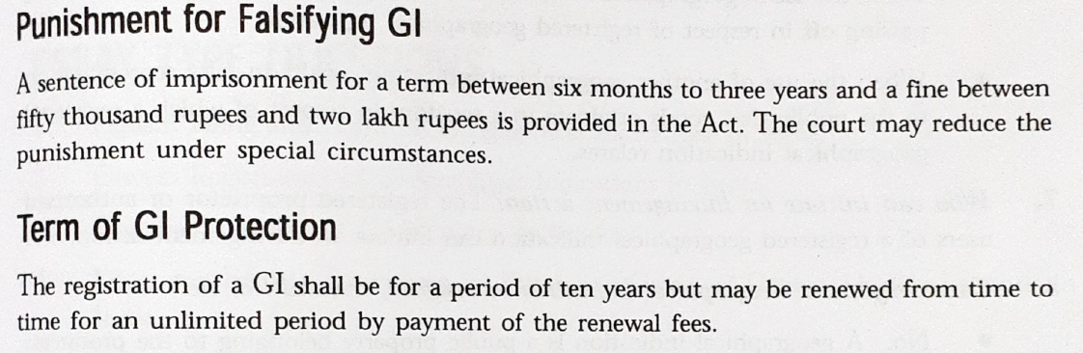
Protection of GI
The concept of identifying GI and protecting them is a new concept in India, perhaps in most developing countries and has come to knowledge after signed the TRIPS agreement.
Properly protected GI will give protection in domestic and international market.
TRIPS provide for refusal or invalidation of registration of a trademark containing a GI with respect to goods not originating in the territory indicated

